Slide 1
Effective Peer Instruction using Clickers
Peter Newbury STLF, Physics and Astronomy
newbury@phas.ubc.ca
Cynthia Heiner STLF, Physics and Astronomy
heiner@phas.ubc.ca
5 December 2011

Slide 2
Schedule
9:00 – 9:30 am | coffee and refreshments
9:30 – 10:45 am | demonstration and discussion of effective peer instruction “choreography”, reacting to students’ votes
10:45 – 11:00 am | coffee break
11:00 am – 12:00 pm | practice running peer instruction episodes
12:00 – 12:30 pm | clicker points, technical support
12:30 pm – 1:00 pm | lunch (provided)
1:00 pm – 2:30 pm | Workshop 2: Creating good clicker questions in physics and astronomy

Slide 3
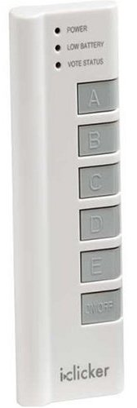
Typical Peer Instruction Episode
Instructor poses multiple-choice question.
Students think about question on their own.
Students vote for an answer using clickers,
coloured cards, ABCD voting cards,...
The instructor reacts, based on the distribution of votes. (We’ll be discussing different reactions today.)

Slide 4
Peer Instruction
In effective peer instruction,
students teach each other immediately, while
they may still hold or remember their novice misconceptions
students discuss the concepts in their own language
students learn and practice how to think, communicate like scientists
the instructor finds out what the students know (and don’t know) and reacts

Slide 5
Peer Instruction
Effective peer instruction requires
identifying key concepts, misconceptions
creating multiple-choice questions that require deeper thinking and learning
facilitating peer instruction episodes that spark student discussion
resolving the misconceptions (unless leaving the question temporarily unresolved is part of the lesson plan)
before
class
during
class

Slide 6
Example Questions
Don’t concentrate only on the content
of the example questions.
Watch the “choreography”, too.

Slide 7
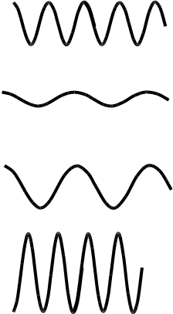
Clicker question
The amplitude and frequency of 4 light waves are shown. The waves are representative of one instant in time and are all travelling in vacuum. Which wave travels the fastest?
A)
B)
C)
D)
E) all the same speed

Slide 8
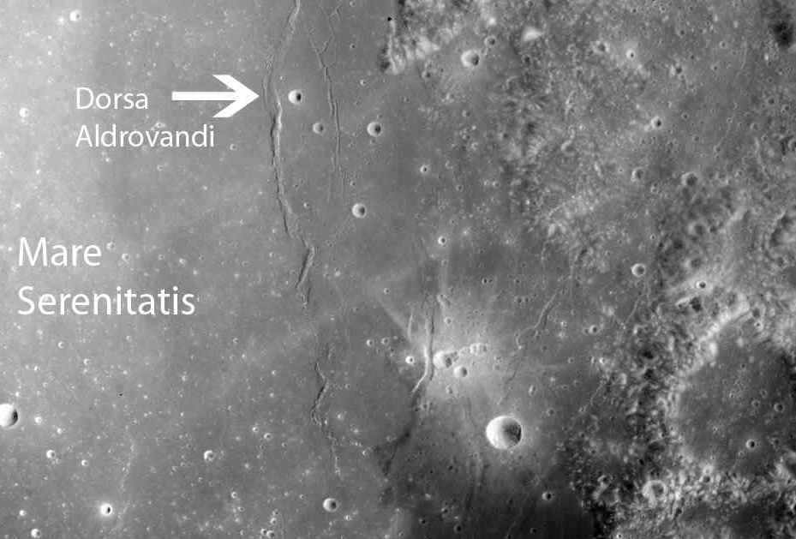
Clicker question
X
Are features X and Y ridges or valleys?
X=ridge, Y=valley
X=valley, Y=ridge
both are ridges
both are valleys
Y

Slide 9
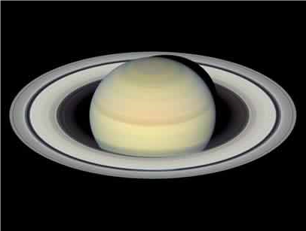
Clicker question
Suppose Saturn’s ring is a solid ring of material, spinning like a DVD. Which graph shows the how the speed of ring particles depend on their distance from Saturn?
A
B
C
fast
fast
fast
Speed
Speed
Speed
slow
slow
slow
center
Distance
edge
center
Distance
edge
center
Distance
edge

Slide 10
Clicker choreography
To be effective, the instructor needs to run the peer instruction in a way that gives students sufficient time to think about, discuss and resolve the concepts.
We want students to participate without ever having to stop and think, “What am I supposed to do now?”

Slide 11
Clicker choreography
Present the question. Don’t read it aloud.
Reasons for not reading the question aloud:
your voice may give away key features or even the answer
you might read the question you hoped to ask, not the words that are actually there
the students are not listening anyway – they’re trying to read it themselves and your voice may, in fact, distract them

Slide 12
Clicker choreography
“Please answer this on your own.”
Goals of the first, solo vote:
get the students to commit to an choice in their own minds
get the students to commit to a choice so they’ll be curious about the answer
get the students prepared to have a discussion with their peers, if necessary
If they discuss the question right way:
students are making choices based on someone else’s reasoning
those students cannot contribute to the peer instruction as they have no ideas of their own

Slide 13
Clicker choreography
“Please answer this on your own.”
Students may be reluctant to quietly think on their own. After all, they have a better chance of picking the right choice after talking to their friends.
“Answer this on my own? Yeah, right!”
If you’re going to impose a certain behaviour on the students, getting their “buy-in” is critical. Explain to them why the solo vote is so important. Explain it to them early in the term and remind them when they start drifting to immediate discussions.

Slide 14
Clicker choreography
Don’t start the i>clicker poll. Instead give the students sufficient time to make a choice. What is sufficient?
Turn to the screen, read and answer the question as if you are one of your students.
Another possibility: keep facing the class, helping those with confused stares.
Another possibility: model how to think about the question by “acting it out.”
When you notice students picking up their clickers and getting restless, they are prepared to vote.

Slide 15
Clicker choreography
When you have made a choice or when you see the class getting restless, ask the students, “Do you need more time?”
“Yes!” Give them a few more seconds.
“[silence]” Ask them to prepare to vote.
If many students are not ready to vote, they will not have committed to a choice and will be unprepared to discuss the question.
Some students may be uncomfortable asking for more time. Make it clear, from the first class, that you’ll honour the request with no repercussions to the student who asked.

Slide 16
Clicker choreography
“Please vote. You have 30 seconds.”
If you’ve given them sufficient time to commit to a choice, the voting should take very little time.
Another option: watch the number of votes and when most of the votes are in say, “Can I have your final answers, please?”.
Having a set routine will help the students recognize “now is the time for thinking”, “now is the time for voting”, “now is the time for discussing”...

Slide 17
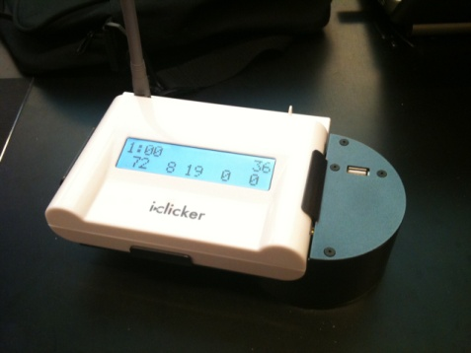
Clicker choreography
Check distribution of votes on the i>clicker receiver.
Don’t show the histogram to the class (yet):
if there is a popular choice, students are apt to vote for it in a 2nd vote, without reasoning why.
a student who picked an unpopular choice is very unlikely to participate in peer or class discussion
You can motivate students without showing the histogram, e.g., by saying “there seem to be two popular answers”
The students’ behaviours will change when they see the histogram, probably not for the right reasons.

Slide 18
Clicker choreography
Depending on the distribution of votes, proceed.
We’ll discuss reacting to various distribution scenarios in a few moments.

Slide 19
Clicker choreography
At the end, confirm the answer(s) and continue with the class.
Even if more than 80–90% of the students have picked the correct choice, some students are still not sure why that choice is correct.
Briefly confirm the correct choice:
explain why the correct choice is correct
if the other choices were carefully chosen, explain why the incorrect choices are incorrect
allows those who chose the correct answer to make sure they had the correct reasoning

Slide 20

Reacting to their votes
You don’t know what’s going to happen but you can anticipate and prepare yourself for the likely outcomes.
When you know the first-vote distribution (but they don’t) you have lots of options.
This is where you show your “agility.”

Slide 21
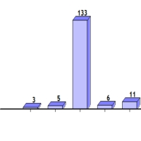
What do you think you should do with this first-vote distribution?
(C is the correct answer)
A | B | C | D | E
“Turn to your neighbours and convince them you’re right”
move on – everyone got it
confirm correct answer and move on
“Can someone who answered C tell us why they made that choice?”
other

Slide 22
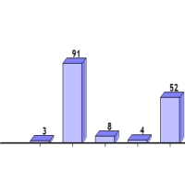
What do you think you should do with this first-vote distribution?
A | B | C | D | E
“Turn to your neighbours and convince them you’re right”
confirm correct answer and move on
“Can someone who answered B tell us why they made that choice?”
“Would someone like to explain why they picked the answer they did?”
other

Slide 23
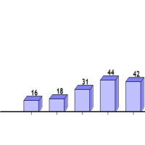
What do you think you should do with this first-vote distribution?
A | B | C | D | E

Slide 24
What do you think you should do with this first-vote distribution?
(C is not the correct answer)
A | B | C | D | E

Slide 25
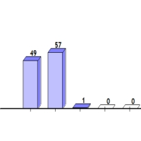
What do you think you should do if this is the second-vote distribution?
A | B | C | D | E

Slide 26
Reacting to their votes
When you know the first-vote distribution (but they don’t) there are many options. You can
confirm and move on
ask the students to discuss with their peers
ask students to advocate for the choices they made
check that the question made sense
eliminate one or more choices before re-voting
and more...
This is where you show your “agility”.

Slide 27
Coffee break
Please select a question if you haven’t yet.

Slide 28
Peer instruction practice
Take 5 minutes to look carefully at your question:
figure out the right answer (and why it’s right)
try to identify the errors or misconceptions behind each distractor
anticipate and prepare yourself for possible distributions of votes
review the choreography
Feel free to write notes on your question and work from those notes – no need to memorize (yet!)

Slide 29
high
Student engagement
(and learning)
low
none
participation
correct
Clicker points

Slide 30
high
“I want to reward those who get it right”
Student engagement
(and learning)
“If it’s not worth marks, students won’t do it.”
low
none
participation
correct
Clicker points

Slide 31
high
“I want to reward those who get it right”
Student engagement
(and learning)
If correct answers are worth points, students worry too much about getting it right, apt to mimic “bright” students.
High-stakes inhibit discussion.
low
none
participation
correct
Clicker points

Slide 32
high
If you convince your students peer instruction is important, through
● continual use (that is, you value it)
● repeated reminders
● nearly-identical questions on
homework and exams
then points may not be necessary
Student engagement
(and learning)
“If it’s not worth marks, students won’t do it.”
low
none
participation
correct
Clicker points

Slide 33
high
If you believe peer instruction is important for learning and you expect students to engage, you can reward their effort.
Student engagement
(and learning)
However, if students perceive clickers are used to test for failure or simply to take attendance, they will disengage.
low
none
participation
correct
Clicker points

Slide 34
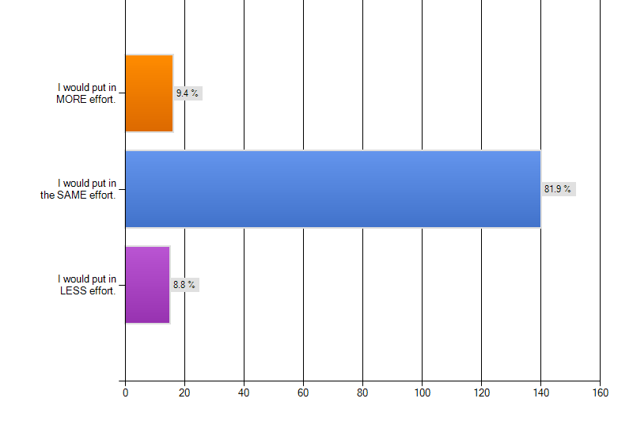
If the clickers were marked for participation ONLY
“Either way I still would try to get the answer I think is most correct. I would still think about the question and would not just guess.”

Slide 35
high
You have to willing and able to “sell” your students on the importance of peer instruction. That’s not easy, especially when you’re a newcomer to peer instruction and clickers.
Student engagement
(and learning)
At first, give yourself a safety net by rewarding students with points.
Later, when you’re comfortable and agile, you might think about eliminating points.
low
none
participation
correct
Clicker points

Slide 36
i>clicker support
wiki.ubc.ca/Clickers
  iClicker/iGrader download for PCs and Macs
  check if your classroom is set up
  learn how the students can register their clicker IDs
  adding a class roster using VISTA (for PCs & Macs)
  sync’ing igrader marks with VISTA
  wiki.ubc.ca/Documentation:Clickers/iClicker_FAQ_for_instructors
  UBC Clicker Support: Michael Tang and Joe Zerdin
  <clicker.support@ubc.ca> IKBLC Room 102

Slide 37


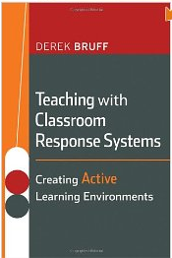
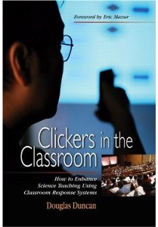

Resources
Check the clicker resources pages on the CWSEI website:
http://www.cwsei.ubc.ca/resources/clickers.htm
(with links to collections of peer instruction questions)
CWSEI
Eric Mazur
(1996)
Derek Bruff
(2009)
Doug Duncan
(2004, 2005)

Slide 38
Thanks
Doug Bonn – Department Head, Physics and Astronomy
Sarah Gilbert – Acting Director, Carl Wieman Science Education Initiative
Georg Rieger – PHAS CWSEI director
Stephanie Chasteen – University of Colorado, Boulder
Jim Carolan (PHAS), Louis Deslauriers (PHAS), Francis Jones (EOS), Katya Yurasovskaya (Math), Malin Hansen (Zoology), Guitri Yapa (Stats), Brett Gilley (EOS), Jared Taylor (Zoology), Josh Caulkins (RITES), James Day (PHAS), Warren Code (Math), Mandy Banet (LifeSci), Costanza Piccolo (Math), Natasha Holmes (PHAS), Michael Tang (UBC Clicker Support, CTLT)
The choreography described here is based on techniques developed at the Center for Astronomy Education at the University of Arizona (astronomy101.jpl.nasa.gov), adapted to using i>clickers.
and you
for investing your time and energy to participate today

Slide 39
PHYS 101 student feedback about clickers

Slide 40
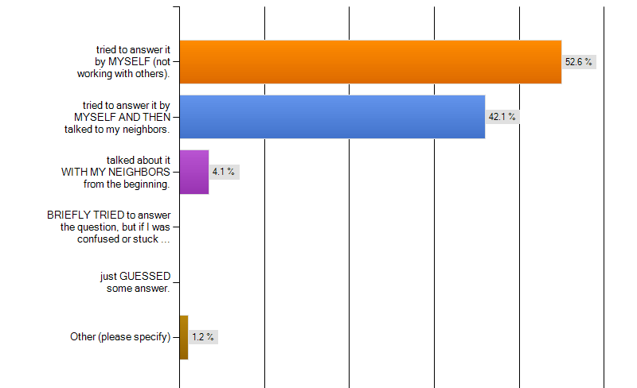
The first time a clicker question was asked in class, I usually …

Slide 41
When you did try to answer the clicker questions, what MOTIVATED you to do so?
“I wanted to see if I knew as much as the rest of the class.”
“They are very helping to understanding concepts.”
“Get that doubt out of my head.”
“To check if I was on the right track with my thinking.”
“It tests my understanding and wanting to get the question right.”
“The clickers are a good way to stay involved in the lecture material”
“They're fun! Also excellent practice for concept questions.”

Slide 42
some student comments about clickers
“I really disliked the idea at first (coming from a small college it was a new thing for me) because I didn't want to pay for it (good old cheap student). But, I really like them now and think they are a great way to reinforce material and promote active listening as a student.”
“I find using i-clicker useful because the professor would re-explain if she sees that most of the class isn't understanding.”
“Loved the clicker because it was great to see that other people didn't get it either. Helped me to make friends in the class too.”

