Slide 1
Example clicker questions

Slide 2
Clicker question
A ball is rolling around the inside of a circular track. The ball leaves the track at point P.
Which path does the ball follow?
C
B
D
A
E
P
(Mazur)

Slide 3
Clicker question
Suppose you pass white light through a prism and all of the colours of the spectrum are projected on a screen. If you then put a red filter over your eye and look at the spectrum, what colours do you see?
you see mostly red light; the blue and green disappears
you see mostly blue light; the other colours disappear
all of the colours turn red
(Duncan)

Slide 4
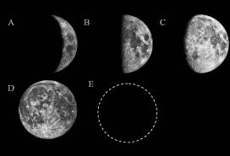
Clicker question
If this is the phase of the Moon when it rises:
what is the phase of the Moon 12 hours later?
A
B
C
D
E
(Prather)

Slide 5
Clicker question
Susan throws a ball straight up into the air. It goes up and then falls back into her hand 2 seconds later.
Draw a graph showing the velocity of the ball from the moment it leaves her hand until she catches it again.
velocity
time
0
2 sec

Slide 6
Which one is the closest match to your graph?
velocity
velocity
A
B
time
time
0
2 sec
0
2 sec
velocity
velocity
C
D
time
time
0
2 sec
0
2 sec
E) some other graph

Slide 7
Clicker question
John is walking to school. This graph shows his position as a function of time. When is John moving with the greatest velocity?
position
time
A
B
C
D
E

Slide 8
Clicker question
Which of the following is an incorrect step when using the substitution method to evaluate the definite integral
none of the above
(Bruff)

Slide 9
Clicker question
To minimize the work you do getting a heavy bag of groceries from the first floor to the second floor of a building, you should
carry the bag up the stairs
carry the bag up in an elevator
put the bag on the floor of an elevator, ride up with it, and then pick up the bag again
carry the bag up a ramp
put the bag in a cart and push it up a ramp
(Chasteen)

Slide 10
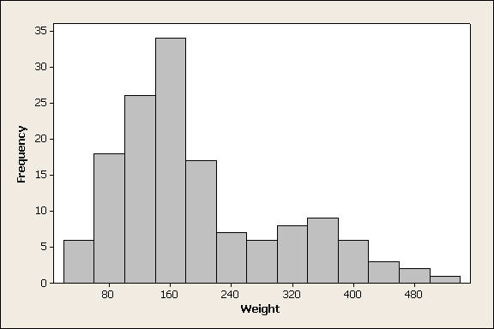
Clicker question
For the data set displayed in the following histogram, which would be larger, the mean or the median?
mean
median
can’t tell from the given histogram
(Peck, mathquest.carroll.edu/resources.html)

Slide 11

Clicker question
An ice cube is floating in a glass of water that is filled entirely to the brim. As the ice cube melts, the water level will
stay the same, remain at the brim.
rise, causing the water to spill.
fall to a level below the brim.
cannot say without knowing the density of ice.

Slide 12
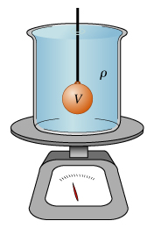
Question
If you lower a 1.5 kg mass on a string into a
5 kg beaker filled with water, what happens to the reading on the scale?
increases to 6.5 kg
increases to a value < 6.5 kg
increases to a value > 6.5 kg
stay the same

Slide 13
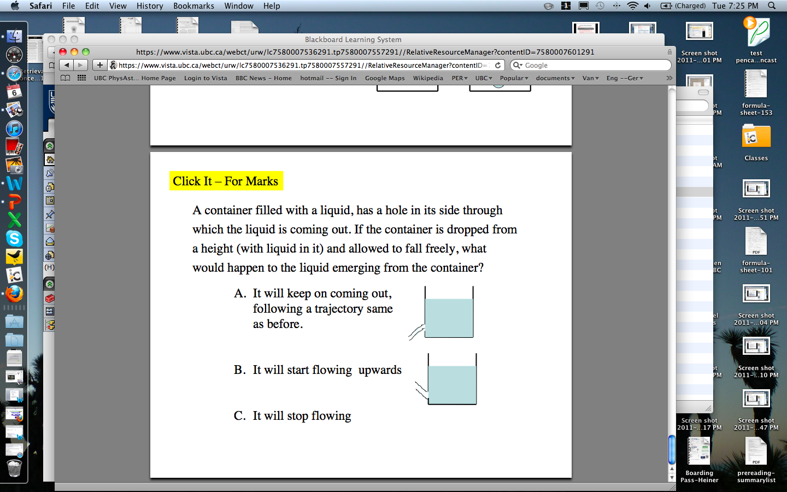
Demo: prediction
A cup filled with water has a hole in the side through which the liquid is flowing out. If the cup is dropped for a height, what will happen to the water flowing from the cup?
It will keep on coming out, flowing the same as before
It will keep coming out, but it will flow a bit slower than before
It will keep coming out, but start to flow upwards
It will keep coming out, flowing horizontally with the falling cup
It will stop flowing
Notes:
SHOULD E be ‘SOMETHING ELSE” and NOT show the right answer. This might force students to trust themselves …

Slide 14
i>clicker
Consider a block of wood that has varying dimensions. Does the pressure exerted on the table from the block depend on the blocks position? If so, which way produces the greatest pressure? If not, why not?
A)
B)
C)
D) The block of wood has the same density, so it doesn’t matter which way it is positioned.
E) The block of wood has the same mass, so it doesn’t matter which way it is positioned.
Notes:
14

Slide 15
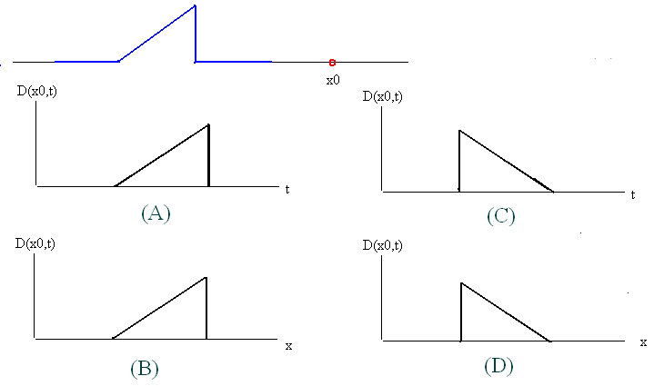
Question
A pulse is moving along a string towards a point located at x0. As the pulse is passing through, the vertical displacement of x0 is correctly described by which of the following graphs?
t
t
x
x

Slide 16
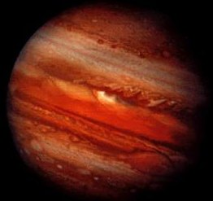

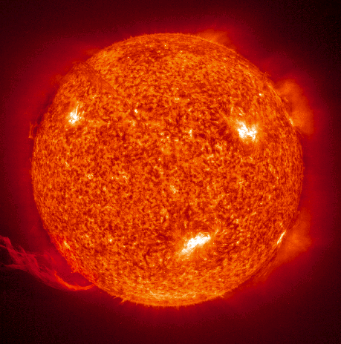
(A)
Which of these has the largest average density?
Jupiter
(B)
Earth
(C)
The Sun
(D) I need more information
http://www.solarspace.co.uk/jupiter.php
http://justearth.net/
http://curious.astro.cornell.edu/sun.php

Slide 17
What about the density of non-uniform objects?
(A)
Which of these has the largest average density?
Jupiter
(B)
Earth
(C)
The Sun
(D) I need more information
http://www.solarspace.co.uk/jupiter.php
http://justearth.net/
http://curious.astro.cornell.edu/sun.php

