Slide 1
Creating Good Clicker Questions in Physics and Astronomy
Cynthia Heiner STLF, Physics and Astronomy
heiner@phas.ubc.ca
Peter Newbury STLF, Physics and Astronomy
newbury@phas.ubc.ca
5 December 2011

Slide 2
Schedule
1:00 pm – 2:30 pm | peer instruction, what makes a good question?
 | different types of clicker questions / when to ask a clicker question
 | create a clicker question
 | share your question with the group and get feedback

Slide 3
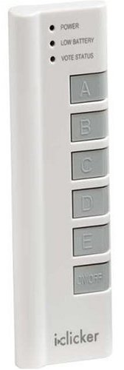
Typical Peer Instruction Episode
Instructor poses multiple-choice question.
Students think about question on their own.
Students vote for an answer using clickers,
coloured cards, ABCD voting cards,...
The instructor reacts, based on the distribution of votes.

Slide 4
Peer Instruction
In effective peer instruction,
students teach each other immediately, while they may still hold or remember their novice misconceptions
students discuss the concepts in their own language
students learn and practice how to think, communicate like scientists
the instructor finds out what the students know (and don’t know) and reacts

Slide 5
Peer Instruction
Effective peer instruction requires
identifying key concepts, misconceptions
creating multiple-choice questions that require deeper thinking and learning
facilitating peer instruction episodes that spark student discussion
resolving the misconceptions (unless leaving the question temporarily unresolved is part of the lesson plan)
before
class
during
class

Slide 6
What makes a good clicker question?
clarity | Students should waste no effort trying to figure out what’s being asked.
context | Is this topic currently being covered in class?
connection to learning goals | Does the question make students do the right thing to demonstrate they grasp the concept.
distractors | What do the “wrong” answers tell you about students’ thinking?
difficulty | Is the question too trivial? too hard?
stimulates thoughtful discussion | Will the question engage the students and spark thoughtful discussions? Is there potential for you to be “agile”?

Slide 7
Clicker question
How many of these are reasons for the seasons?
the height of the Sun in the sky during the day
Earth’s distance from the Sun
how many hours the Sun is up each day
none of them
one
two
all three
clarity context learning goals distractors difficulty discussion

Slide 8

Clicker question
An ice cube is floating in a glass of water that is filled entirely to the brim. As the ice cube melts, the water level will
stay the same, remain at the brim.
rise, causing the water to spill.
fall to a level below the brim.
cannot say without knowing the density of ice.
clarity context learning goals distractors difficulty discussion

Slide 9
Types of questions and when to ask them

Slide 10
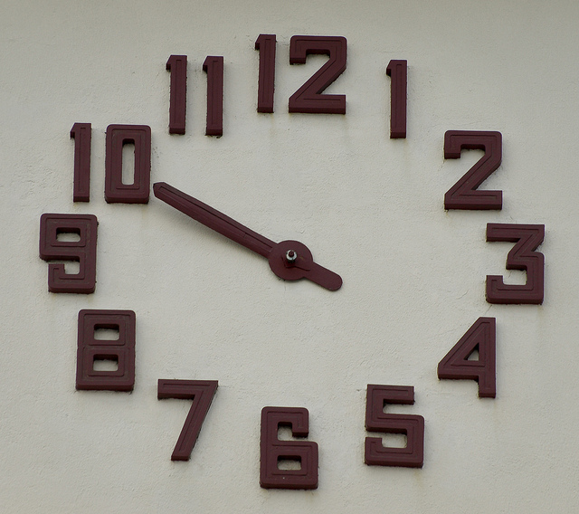
BEFORE:
setting up instruction
AFTER:
assessing learning
assess prior knowledge
provoke thinking
exit poll
predict
motivate
review / recap
discover
“big picture”
check knowledge
demonstrate success
real world application
exercise skill
analysis
probe misconception
synthesis
evaluation
DURING:
developing knowledge
Rosie Piller, Ian Beatty, Stephanie Chasteen
clock by airdiogo on flickr CC

Slide 11
Create your own clicker questions
(20 minutes)
Find a partner (similar discipline if possible)
Identify a concept or learning goal your students have trouble with.
Create a clicker question.
While your writing it, think about
what type of question is it?
when would you present it?
clarity
context
connection to
learning goals
distractors
difficulty
stimulating
thoughtful
discussion

Slide 12


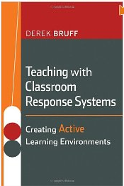
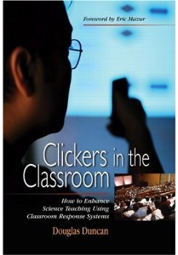
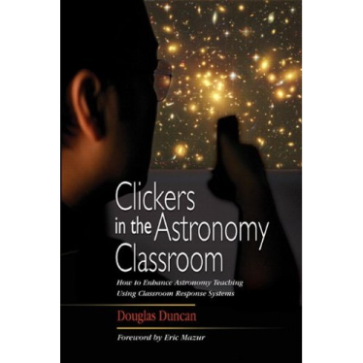
Resources
Check the clicker resources pages on the CWSEI website:
http://www.cwsei.ubc.ca/resources/clickers.htm
(with links to collections of peer instruction questions)
CWSEI
Eric Mazur
(1996)
Derek Bruff
(2009)
Doug Duncan
(2004, 2005)

Slide 13
Thanks
Doug Bonn – Department Head, Physics and Astronomy
Sarah Gilbert – Acting Director, Carl Wieman Science Education Initiative
Georg Rieger – PHAS CWSEI director
Stephanie Chasteen – University of Colorado, Boulder
Jim Carolan (PHAS), Louis Deslauriers (PHAS), Francis Jones (EOS), Katya Yurasovskaya (Math), Malin Hansen (Zoology), Guitri Yapa (Stats), Brett Gilley (EOS), Jared Taylor (Zoology), Josh Caulkins (RITES), James Day (PHAS), Warren Code (Math), Mandy Banet (LifeSci), Costanza Piccolo (Math), Natasha Holmes (PHAS), Michael Tang and Joe Zerdin (CTLT)
and you
for investing your time and energy to participate today

Slide 14
Example clicker questions

Slide 15
Clicker question
predict
A ball is rolling around the inside of a circular track. The ball leaves the track at point P.
Which path does the ball follow?
C
B
D
A
E
P
(Mazur)

Slide 16
Clicker question
real world
application
Suppose you pass white light through a prism and all of the colours of the spectrum are projected on a screen. If you then put a red filter over your eye and look at the spectrum, what colours do you see?
you see mostly red light; the blue and green disappears
you see mostly blue light; the other colours disappear
all of the colours turn red
(Duncan)

Slide 17
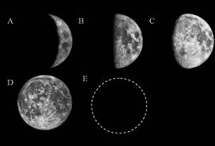
Clicker question
probe
misconception
If this is the phase of the Moon when it rises:
what is the phase of the Moon 12 hours later?
A
B
C
D
E
(Prather)

Slide 18
Clicker question
exercise skill
Susan throws a ball straight up into the air. It goes up and then falls back into her hand 2 seconds later.
Draw a graph showing the velocity of the ball from the moment it leaves her hand until she catches it again.
velocity
time
0
2 sec

Slide 19
Which one is the closest match to your graph?
velocity
velocity
A
B
time
time
0
2 sec
0
2 sec
velocity
velocity
C
D
time
time
0
2 sec
0
2 sec
E) some other graph

Slide 20
Clicker question
analysis
John is walking to school. This graph shows his position as a function of time. When is John moving with the greatest velocity?
position
time
A
B
C
D
E

Slide 21
Clicker question
evaluation
Which of the following is an incorrect step when using the substitution method to evaluate the definite integral
none of the above
(Bruff)

Slide 22
Clicker question
“big picture”
To minimize the work you do getting a heavy bag of groceries from the first floor to the second floor of a building, you should
carry the bag up the stairs
carry the bag up in an elevator
put the bag on the floor of an elevator, ride up with it, and then pick up the bag again
carry the bag up a ramp
put the bag in a cart and push it up a ramp
(Chasteen)

Slide 23
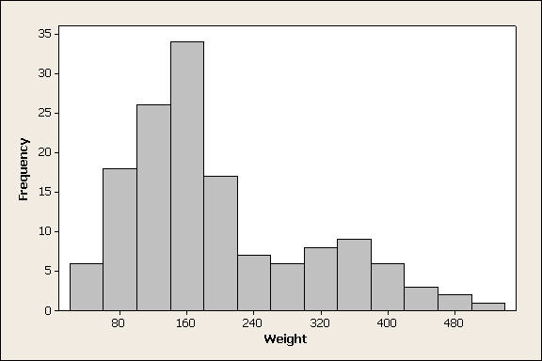
Clicker question
check knowledge
For the data set displayed in the following histogram, which would be larger, the mean or the median?
mean
median
can’t tell from the given histogram
(Peck, mathquest.carroll.edu/resources.html)

Slide 24
Clicker question
provoke thinking
Can your eyes resolve things better at night or during the day?
you can resolve things better at night
you can resolve things better during the day
you can resolve things the same during the day and at night

Slide 25
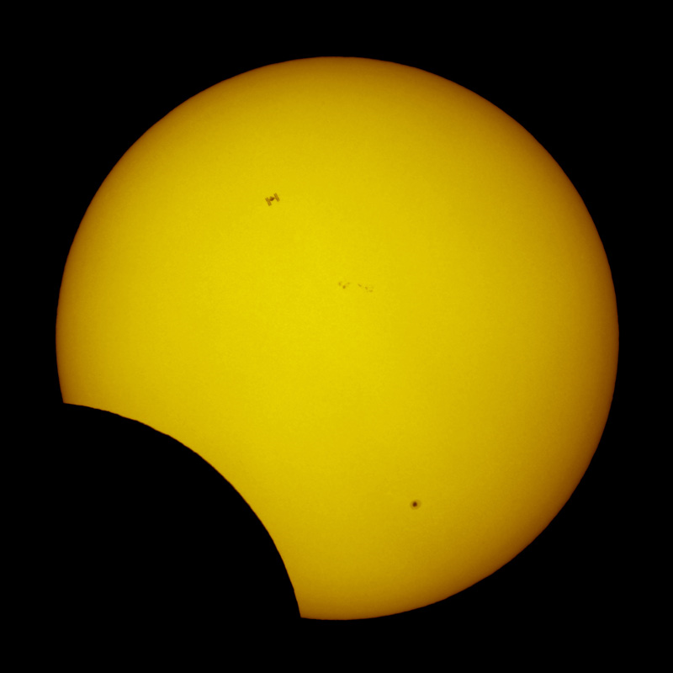
What do you think is most interesting about this picture?
discover
lunar eclipse
solar eclipse
cloud blocking the Sun
sunspots
other
Astronomy Picture of the Day
2011 January 5

Slide 26
Clicker question
“big picture”
String 1 has a linear mass-density of 3.00 g/cm and string 2 has a linear mass density of 5.00 g/cm. They are under tension due to a hanging block of mass M = 500 g. (a) Calculate the wave speed in each string.
Which equation sets up the problem correctly?
1
2
T₁ + T₂ = mg, where T1≠ T2
T₁ - T₂ = mg, where T1≠ T
2T = mg
2T = -mg
choices C & D are correct because we are only concerned with magnitude
M
Notes:
Sort of all over – this was helpful to get the students on the right track, so that they could move forward and answer (b). Also, students kept asking don’t they need the length and mass, apparently giving them ‘linear mass-density’ was too vague. Probably want to include ‘mu’.

Slide 28
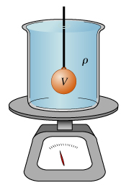
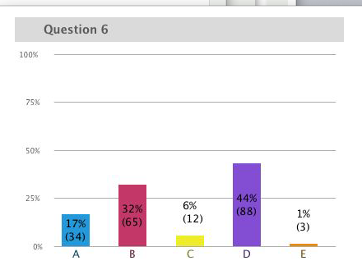
Question
If you lower a 1.5 kg mass on a string into a 5 kg beaker filled with water, what happens to the reading on the scale?
increases to 6.5 kg
increases to a value < 6.5 kg
increases to a value > 6.5 kg
stay the same

Slide 29
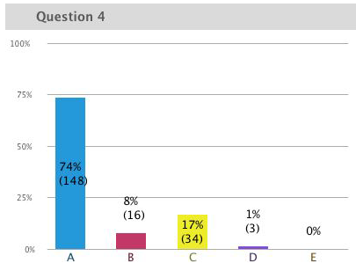
Prediction
An ice cube is floating in a glass of water that is filled entirely to the brim. As the ice cube melts, the water level will
A. stay the same, remain at the brim.
B. rise, causing the water to spill.
C. fall to a level below the brim.
D. cannot say without knowing the
density of ice.
Notes:
STT15.4

