Slide 1
New Science Faculty Workshop
#1 Science of Learning
Carl Wieman-- physics
Essential elements for learning
Consistent research results from cognitive psychology, brain, education, university science classrooms
approach learning/teaching science like science
today-- discuss/model most important elements
next session-- ways to implement principles in classes (CWSEI)
summarize bunch of research-- sources,
a. refs on cwsei website, b. will list a few later, c. ask me
d. ask stlfs in your department if in CWSEI

Slide 2
Most new faculty waste a lot of time on teaching
today and next week, helping you avoid that
Lots of time preparing lectures: details of content (studying in depth), delivery, notes, worrying about avoiding student conflict,...)
little difference to student learning
seven principles of learning (from research)
~90% of what matters

Slide 3
Survey of your background
q1. My teaching experience before this term is
a. none, b. as TA multiple terms, c. taught only 3rd & 4th level course(s), d. taught 1st & 2nd yr course(s) only , e. have taught both upper and lower level courses as instructor
q2. My teaching experience has been
a. extensive (multiple courses) at both UBC and elsewhere
b. mostly at UBC, c. mostly elsewhere
q3. I have
a. read multiple papers/books on both teaching methods and teaching and learning research,
b. read 1 to 3 papers on teaching methods only
c. read 1-3 papers on teaching or learning research
d. not read any papers, but have gone to teaching workshop
e. not read any papers or gone to any workshops

Slide 4
Principle of learning #1-- all learning involves connecting up with and building on prior thinking and knowledge base
to teach effectively-- must find out student prior thinking and connect with it.
?? 
on to next principle

Slide 5
My biggest fear when I get up in front of a class is that a. I will mess up an explanation and look stupid b. the students will not like me as a person c. the students will be bored d. the students will not learn the material e. I will lose control of the class and students will be talking and doing other disruptive things. if your biggest fear is something other than one of the above, do not vote, but be prepared to tell.

Slide 6
What you want to get out of these first two new faculty workshops?
Pick the most important goal
a. make Dean or Head happy with me.
b. meet other new faculty.
c. learn to teach more effectively.
d. reduce level of stress and/or time I spend on teaching.
e. other
What is second most important goal, if more than one of these are important to you?
discuss goals, how can they best be achieved today?
Now I know your greatest concerns and desires ☺
-- can address in discussion

Slide 7
Principle of learning #2 Motivation to learn is essential. Is necessary element of teaching.
Learning is inherently hard work.
Requires changing brain, much like muscle development.
Demands strenuous extended effort. Humans will not do without motivation.
Motivation comes in various types--
a. external (Dean, tenure, salary, praise for success, threats, grades, parents)
mostly “hard-wired”-- linked to basic needs
b. internal (interesting, useful, satisfying)
mostly learned from culture, experience, persuasive teachers, ...

Slide 8
a few relevant things we know about motivation
1. Is complex subject
2. Internal motivation longer lasting but more complex to achieve.
3. Threats and competition motivate some people
(overrepresented in science and engineering)
but demotivates others (most?).
“Prof says 30% will fail, means he doesn’t care about my learning in this course, and so I want to have as little to do with it as possible.”
4. Seeing usefulness/application of ideas in context a person can relate to increases interest, is motivating.
5. Achieving sense that can be successful in subject is motivating. (and vice-versa, usually)
?? 
on to next principle

Slide 9
What is the single most important element needed for an instructor to teach a science topic effectively?
think briefly, offer individual suggestions, then will discuss these in small groups as to which one is best and why, then vote.
a. clarity
b. motivate students.
c. engagement
d. charisma and/or trust (personal characteristics)
e. feedback and guidance
if want one of others, dont vote-- will raise hand

Slide 10
Principle #3-- engagement. People must think hard about a subject to learn it.
(and problems or questions can be quite ambiguous without any clear correct answer to be engaging--often best)
Unless brain is thinking hard about topic, not building proteins
and putting them together to form long term memory.
But is thinking hard about subject enough?
obviously not

Slide 11
Principle of learning #4 Need effective feedback--Guidance that shapes thinking and learning.
Essential elements of effective feedback
a. timely-- when still thinking about subject, not after midterm
3 weeks after topic was finished.
b. specific-- not just right or wrong, but why right or why wrong.
Guidance (“coaching”) how to think about better.
Requires knowing what person is thinking!
measuring student thinking & mastery to then provide timely specific feedback= “formative assessment”
?? 
on to next principle

Slide 12
Teaching to think like experts.
Understanding expert-novice differences and what is involved in becoming more expert-like

Slide 13
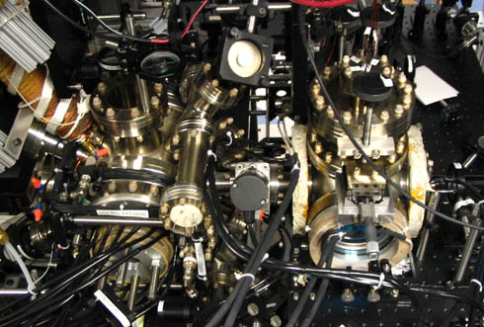
What do you see?

Slide 14
What do I see-- chambers with windows normally used for ultra high vacuum work. Bunch of adjustable mirrors near windows so likely are doing some sort of controlling or probing of isolated atoms in chamber using laser beams.
Are two chambers, one of which has orange heating film on one arm, so likely is using to inject vapor into left chamber and do something to it before it goes into right chamber. Normal reason to do that would be differential pumping so right hand chamber low pressure with small well controlled sample of atoms from left coming into it, being controlled or probed with laser light. Heavy black cables running in probably means are using large magnetic fields -- likely to control or trap atoms. Heater tape + color of mirrors= Rb or Cs.
See patterns and associations-- knowledge organized in certain way because of expertise. Consistent across all disciplines.

Slide 15
Experts don’t just know more, they have knowledge organized in special way so access and apply it very effectively.
“Effectively access and apply knowledge” DEFINES useful learning of science. Heart of “transfer” -- apply ideas in new contexts.
“Scientific concepts” are organizational structure.
Is why learning by memorization & plug-and-chug mentality
so limiting-- not expert-like. (& is borrrinnng!)
But, if only the steps, not expert thinking behind choice of steps is displayed and p. & c. works on exams , what does novice think?
Very hard to recognize and put yourself into different mental framework

Slide 16
If expert, hard to recognize when student using rote memorization
rather than conceptual understanding and reasoning.
If student, hard to recognize conceptual understanding and methods.
Brains wired differently, information organized differently.
“Curse of knowledge”

Slide 17
Principle of learning #5 Expert thinking involves more than knowing information, is also how information is organized, applied, and learned.
Develops only with active and explicit construction to change how brain is “wired” .
To teach, provide tasks that require practicing expert-like thinking-- recognizing patterns, modeling, making connections, organizing information around concepts, transfer to new situations, ...
“Teaching Expert Thinking” 2 pg CWSEI guide-- handout
Harder and more important to learn and longer lasting than facts.
Have to not just teach what to learn, but also what is real learning, and how to learn!
Waste most students who did not learn the what is and how of expert learning some other way

Slide 18
Research-- lots on expertise and how develop.
Here-- some data from physics courses to illustrate.
I. Paired quantitative calculational and
conceptual problems.
(Eric Mazur)
1 Ω
8 V
B
A
2 Ω
On exam 70% can calculate currents and voltages in this complex circuit.
12
V
1 Ω
Change in brightness of bulbs when switch closed?
Only 40% correctly predict!

Slide 19
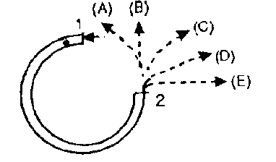
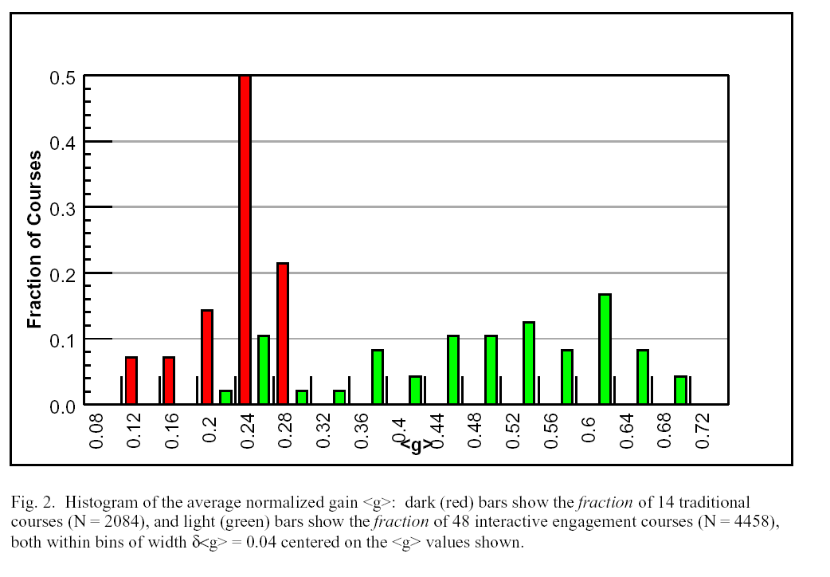
II. Force Concept Inventory- learning basic concepts of force and motion 1st semester physics
Ask at start and end of semester--
What % learned? (100’s of courses)
Average learned/course
16 traditional Lecture
courses
improved
methods
?? 
Fraction of unknown basic concepts learned
On average learn <30% of concepts did not already know.
Lecturer quality, class size, institution,...doesn't matter!
Similar data for conceptual learning in other courses.
R. Hake, ”…A six-thousand-student survey…” AJP 66, 64-74 (‘98).

Slide 20
on to new principle
read text

Slide 21
memory model explanation
neuron
signals in
signal out

Slide 22
memory model explanation
neuron
signals in
signal out
cells in part of the brain that deals with memory get conditioned by multiple input signals to enhance output signal, effect is long lasting.

Slide 23
Principle of Learning #6 Part of memory that remembers and process ideas on short times scales extremely limited capacity!
More loaded down, less well it processes, less learned.
Maximum capacity 4-7 separate items. Beyond that can’t
remember or process.
Amount of working memory required highly expertise dependent!! In long term memory, no load on working memory.

Slide 24
Reducing unnecessary demands on working memory improves learning.
Reduce unnecessary demand on working memory aids learning.
How accomplished in example?

Slide 25
Reducing demands on working memory:
Eliminate unfamiliar jargon or extraneous information.
Translation of words into image or process.
Connect new information or ideas to stuff in long term memory
(show where is same or closely related to previous ideas, use analogies, ...)
Showing organization and relationships (“chunking”)
?? 

Slide 26
if time
Useful retention
Principle of learning #7 Requirements for retention well established.
1. Spaced, repeated retrieval and application (“testing”/using)
2. Multiple associations (“hooks”) with stuff in long term memory
(more the better, “useful” associations--expertise)

Slide 27
Principles of learning:
#1-- all learning involves connecting up with and building on prior thinking and knowledge base
#2 Motivation to learn is essential. Is necessary element of teaching.
#3-- engagement. People must think hard about a subject to learn it.
#4 Need effective feedback--Guidance that shapes thinking and learning.
#5 Expert thinking involves more than knowing information, is also how information is organized, applied, and learned.
#6 Working memory extremely limited capacity!
More demands on it, less learned.
#7 Retention by spaced repeated retrieval & multiple associations
anything missing?

